Slide 1
Game Theory
The maths thing, not the other one

Slide 2
What is it?
Game theory is an area of study within mathematics (and used by economists and political scientists) which builds models of human interaction
Game theory provides a mathematical foundation for generating predictions on group interaction

Slide 3
Games are normally 2 player games
A player in a game is a person or group of people that interact in the same social environment
They are normally restricted by the rules of the game (same as normal games) but only in the sense that we model their actions as 1 of several types of action
The assumption is that players are rational actors within the game, and as we all know, people are very rational…

Slide 4
Types of game
While there are many games within the realm of game theory, I break the games down into 3 types of game, each with 2 subcategories
These groups are not always 100% descriptive of the scenarios of the games being played, they provide a good descriptor of the mechanics and an indicator of best strategies to win the game
Oh and I say “I break the games down”, because apparently I am an “expert” in this topic

Slide 5
Zero Sum Vs Plus Sum
Zero Sum games are resource limited games. If one of the players wants to “win” or increase the amount of resources they have the other player(s) will either have less resources or none at all. So the gains of 1 player should equal the losses of the other.
Plus Sum games, in contrast to zero sum games, allow resources to grow or allow players allocation of resources to be at a cheaper cost to each player.

Slide 6
Cooperative Vs Non-Cooperative
Cooperative or non-competitive games are where players are encouraged to work together.
Non-cooperative or competitive games are where players are encouraged to behave selfishly.

Slide 7
Simultaneous Vs Sequential
Simultaneous games are where players all make their move concurrently, or without knowledge of the other player(s) move(s).
Sequential games happen when each player takes turns making moves, and each player knows what the last move was before they need to decide what move they are going to make.

Slide 8
These are not individual game types
Most games are a combination of the 3 of them
Noughts and Crosses, Chess, and Go are competitive, zero sum games which are played sequentially.
Some games shift dynamically between different categories so they can start cooperative and then become non-cooperative - for example Diplomacy

Slide 9
Information - complete or incomplete
Games contain information - both about the other players and the game rules
Information is either complete or incomplete - i.e. you either know everything or have limited knowledge
Chess is an example of a complete information game as you can know all the possible moves the other player can make

Slide 10
Payouts and Cost
In games players are awarded an amount of points (a payout) for winning the game
Sometimes actions in a game come with a cost of action this means that each action in the game will force the player to use up some resources to perform said action.
Costs are common in most scenarios, e.g. coming to university classes has a cost of not doing something more fun!

Slide 11
Payouts can either be symmetric or asymmetric
So either players can have the same payout and cost for each action, or different players have different payouts and costs for each action
Which means that games are not always fair for all players,
But games can be fair but have different costs and payouts, more on that when we get there

Slide 12
Number of plays - 1 shot or repeated
Games are either 1 shot (so takes place only once) with the same players
Or repeated games where games take place multiple times with the same players
Sometimes repeated games are none-continuous games (players are returned to their original start positions) or the are continuous so any cost or payouts from previous games are carried forward

Slide 13
Games we are going to cover
Chicken
Prisoner's Dilemma
Auction
Snowdrift
Note: There are not all the games that exist but many games are just variations of these or games that cover rare examples.
The games we cover today are applicable to most situations and can be modified to meet the needs of the players and situation

Slide 14
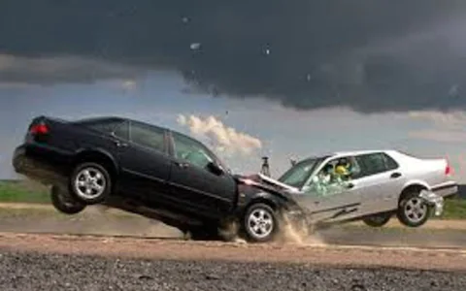
1. Chicken
Chicken is a zero sum, non-cooperative, and simultaneous game
The original scenario is 2 cars driving at each other and each driver has a choice to swerve or carry on driving straight.

Slide 15
Chicken Payout Matrix
Player 1 Player 2 | Swerve | Straight
Swerve | 0, 0 | 1, 0
Straight | 0, 1 | -1000, -1000

Slide 16
Cold War - a game of nuclear chicken
American advisors used chicken to determine how to negotiate with the USSR
Cuban Missile Crisis (1962)
8th September Soviet deliver medium range missiles with nuclear warheads capable a striking Washington DC
Missile sites spotted by U2 spy planes October 19th

Slide 17
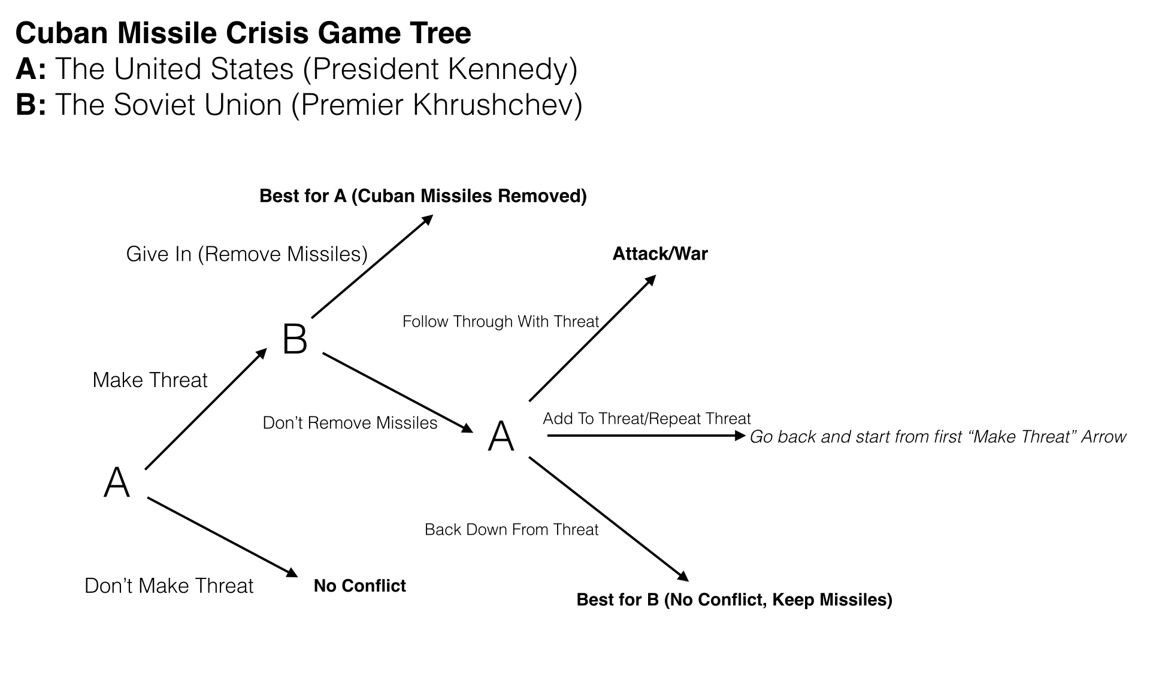

Slide 18
US came up with 6 options
Do nothing: American vulnerability to Soviet missiles was not new.
Invasion: Full-force invasion of Cuba and overthrow of Castro.
Air strike: Use the US Air Force to attack all known missile sites.
Blockade: Use the US Navy to block any missiles from arriving in Cuba.
Secret approach: Offer Castro the choice of splitting with the Soviets or being invaded.
Diplomacy: Use diplomatic pressure to get the Soviet Union to remove the missiles.

Slide 19


Which option?
ⓘ Start presenting to display the poll results on this slide.
Notes:
📣 This is Slido interaction slide, please don't delete it.
✅ Click on 'Present with Slido' and the poll will launch automatically when you get to this slide.

Slide 20
US chose Blockade
US deployed 12 destroyers for the initial blockade ordered to stop and search all ships heading to the northern Caribbean this was later scaled to 1 aircraft carrier, 2 cruisers, 22 destroyers, and 2 guided missile frigates
Soviets deployed an unknown number of submarines armed with nuclear weapons and over 40 warships of various sizes
Each side increased both military and diplomatic efforts to force the other to swerve - US goes to DEFCON 2 (DEFCON 1 is where nuclear weapons are launched)
Germany and China mobilizes troops to prepare for invasions

Slide 21
Soviet Union backs down
After several games of chicken, the USSR swerves and agrees to withdraw its missiles from Cuba
The ships carrying the missiles are turned around and head back to their home ports
The US claims victory and its allies breathe a sigh of relief as the world did not end in a nuclear holocaust or invasion of US and Europe

Slide 22
… or did they? Secret Negotiations
There is 1 part that is often left out of the story
While each side was ramping up world tension (driving straight) members of the KGB were in contact with members of the CIA, FBI, and US State Department seeking a diplomatic solution
And the game transformed from Chicken to Prisoner’s Dilemma

Slide 23
Prisoner’s Dilemma
Prisoner’s Dilemma is a zero sum, cooperative/non-cooperative, and simultaneous game
The standard scenario is 2 prisoners are arrested by the police, placed in separate rooms and given a choice
Either say your partner committed the crime and get set free, or say nothing and go to jail

Slide 24
Prisoner’s Dilemma Payout Matrix
Player 1 Player 2 | Stay Silent | Betray
Stay Silent | 2, 2 | 0, 10
Betray | 10, 0 | 5, 5

Slide 25
Both sides were willing to cooperate from the outset
Instead of playing chicken and driving headlong into a war, both the US and USSR were cooperating for the majority of the crisis, with a few minor defections along the way
A good indication that they were playing Prisoner's Dilemma is the outcome.
Yes, USSR missiles were removed from Cuba, but US missiles were removed from Italy and Turkey as part of the exchange.

Slide 26
Auction Games
Also known as bidding games
There are a wide range of auction games, each has a variety of rules, each changing their overall strategy
Most start off with 2 or more players with a set amount of resources and 1 or more items for each player to bid on to win

Slide 27
Some auction types
Single Blind Bid - all players bid for a single prize but they do not know the value of the prize
Single Visible Bid - all players bid for a single prize knowing the value of the prize
Multiple Blind Bids - All players bid for multiple prizes but do not know the value of any prize
Multiple Visible Bids - Players can bid on a number of prizes where they do know the value

Slide 28
Cost of bidding
Depending on the game rules, when a player bids they might lose their bid regardless if they win or lose. Think of this as the cost of time for doing a certain action - e.g. writing a piece of code for an assessment
Additionally some games are simultaneous, so all bids must be placed before the game starts so each player cannot change their bids after the game begins - again like assessments

Slide 29
Example: 2 visible single bid
3 players each have £10 to bid on 2 prizes
You will lose whatever you bid
So how much do you bid on each box?
£9
£15

Slide 30
Possibilities?
Well there is no point in spending more than £9 on the first prize
But if you place too high a bid on the £9 prize then you probably won’t win the 2nd prize of £15 which is higher than your initial starting bid so you should put more money on the 2nd box
But what if other players also think this? So perhaps placing more money on the 1st prize increases your chances of winning?
£9
£15

Slide 31
Player Choices
 | Prize 1 (£9) bid | Prize 2 (£15) bid | Max Payout
Option 1 | £10 | £0 | -£1
Option 2 | £7 | £3 | £14
Option 3 | £5 | £5 | £14
Option 4 | £3 | £7 | £14
Option 5 | £0 | £10 | £5

Slide 32
Payouts depend on other player choices
Here player 2 splits their bid £5 for each prize
 | Prize 1 (£9) bid | Prize 2 (£15) bid | Max Payout
Option 1 | £10 (£5) | £0 (£5) | -£1 (£10)
Option 2 | £7 (£5) | £3 (£5) | £2 (£10)
Option 3 | £5 (£5) | £5 (£5) | £0 (£0)
Option 4 | £3 (£5) | £7 (£5) | £8 (£4)
Option 5 | £0 (£5) | £10 (£5) | £5 (£4)

Slide 33
Payouts depend on other player choices
Here player 2 splits their bid £3 for the first prize and £7 for the second
 | Prize 1 (£9) bid | Prize 2 (£15) bid | Max Payout
Option 1 | £10 (£3) | £0 (£7) | -£1 (£8)
Option 2 | £7 (£3) | £3 (£7) | £2 (£8)
Option 3 | £5 (£3) | £5 (£7) | £4 (£8)
Option 4 | £3 (£3) | £7 (£7) | £0 (£0)
Option 5 | £0 (£3) | £10 (£7) | £5 (£6)

Slide 34
Payouts depend on other player choices
Here player 2 splits their bid £7 for the first prize and £3 for the second
 | Prize 1 (£9) bid | Prize 2 (£15) bid | Max Payout
Option 1 | £10 (£7) | £0 (£3) | -£3 (£10)
Option 2 | £7 (£7) | £3 (£3) | £0 (£0)
Option 3 | £5 (£7) | £5 (£3) | £10 (£2)
Option 4 | £3 (£7) | £7 (£3) | £8 (£2)
Option 5 | £0 (£7) | £10 (£3) | £5 (£2)

Slide 35
Payouts depend on other player choices
Finally player 2 is bad at maths and splits £10, £0
 | Prize 1 (£9) bid | Prize 2 (£15) bid | Max Payout
Option 1 | £10 (£10) | £0 (£0) | £0 (£0)
Option 2 | £7 (£10) | £3 (£0) | £12 (-£1)
Option 3 | £5 (£10) | £5 (£0) | £10 (-£1)
Option 4 | £3 (£10) | £7 (£0) | £8 (-£1)
Option 5 | £0 (£10) | £10 (£0) | £5 (-£1)

Slide 36
However
While we have added a value to each prize, the prizes might not be worth the same to each player
That £9 item might be worth more to a player if it happens to be a limited edition collectable so has a personal value or a value that shifts over time
And the stake of £10 is not the same value either, £10 for someone with a £80,000pa income is worth less than someone on £15,000pa

Slide 37
Which choice is optimal?
ⓘ Start presenting to display the poll results on this slide.
Notes:
📣 This is Slido interaction slide, please don't delete it.
✅ Click on 'Present with Slido' and the poll will launch automatically when you get to this slide.

Slide 38
Auction games give us 3 strategies
To win as much as possible
Minimise the other players winnings
Deciding not to play as the winnings do not outweigh the costs
But we need to know the rules before we can work out what is best

Slide 39
Auction Game Alternative rules
Only pay if you win the prize
Pay the 2nd highest bid if you win a prize
Bidding is done sequentially
Prizes are divided based on bid contributions

Slide 40
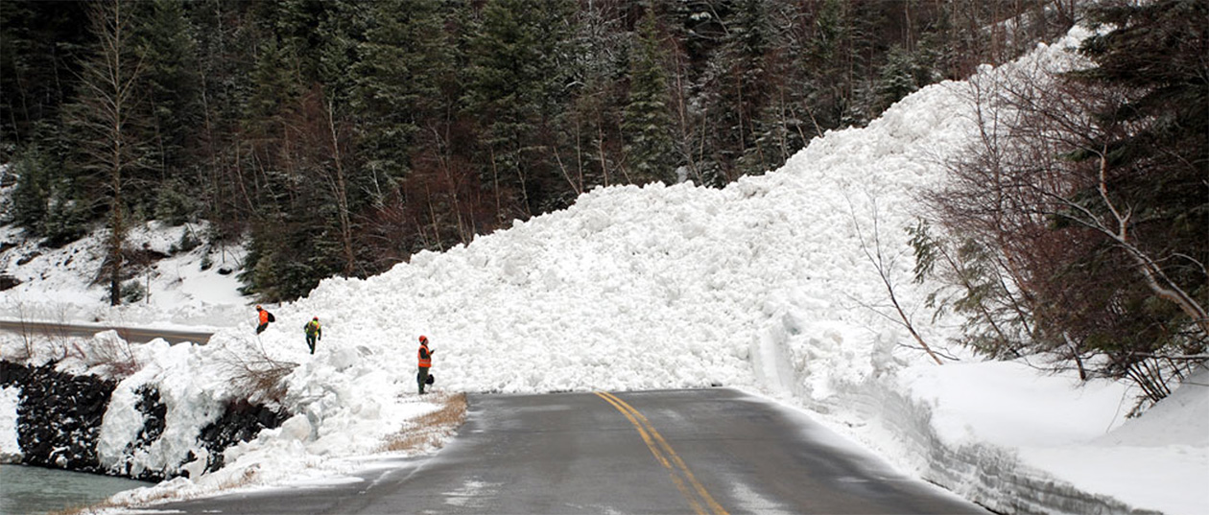
Snowdrift
Cooperative, plus sum, simultaneous
You are out driving in a car when
suddenly an avalanche blocks the road
Both in front and behind you.
You are stuck and cannot drive around. You are 50 km from the nearest shelter and will die if you stay in your car as temperatures are due to drop sharply over night
Your only choice is to clear the snow before you freeze to death…

Slide 41
Shared costs and payouts
There is a physical effort to clear the snow, but you will get to save your life
If there are 2 people clearing the snow, then it will be less effort for each of you to clear the snow and you can both drive to safety
But if you stay in the car and let the other clear the snow, you can still drive to safety, but you have stayed in the warmth of your car

Slide 42
Snowdrift Payout Matrix
Player 1 Player 2 | Stay in Car | Clear Snow
Stay in Car | -1000, -1000 | 100, 300
Clear Snow | 300, 100 | 200, 200

Slide 43
Game Theory, what is the point?
Game theory allows us to create a series of mathematical rules to simulate social situations
We can use this to create AI systems to interact with or monitor human behaviour, even predict future events
We can also develop strategies to work out how best to play these games

Slide 44
Game Strategies
Cooperator - A player that always cooperates
Cooperator Spite - A player that starts off cooperating, then on turn 3 defects for the rest of the match
Defector - A player that always defects.
Random (0.2, 0.5, and 0.8) - A player that chooses randomly with a bias towards cooperation modifier of either 0.2, 0.5, 0.8.
Spiteful Tit for Tat - A player that will cooperate, but will defect permanently after the other player defects twice in a row.
Tit for 2 Tats - A player that mimics the last pair of moves from the other player, or returns previous action.

Slide 45
Game Strategies
Tit for Tat - A player mirrors the actions of the other player.
Tricky Cooperator - A cooperator that will occasionally defect to improve payout.
Tricky Defector - A defector that will occasionally try to trick the other player into cooperating to improve payout.
Two Tits for Tat - A player that will defect twice each time the other player defects.
Tit for Tat Grim - A player that will mimic the lowest cooperation level, e.g. if player plays C, C, D, C, C then this strategy will play C, C, D, D, D.

Slide 46
I made my own game (well 2 really)
1st is modified snowdrift
 | Player 1 | Cooperate | Cooperate | Defect | Defect
Player 2 |  | Strong | Light | Light | Strong
Cooperate | Strong | 200/200 | 225/175 | 250/150 | 300/100
Cooperate | Light | 175/225 | 150/150 | 175/125 | 200/100
Defect | Light | 150/250 | 125/175 | 25/25 | 0/25
Defect | Strong | 100/300 | 100/200 | 25/0 | 0/0

Slide 47
1st experiment
Take each of the major strategies, have them play Prisoner's Dilemma against every other strategy (repeated 10,000 times for each strategy combination)
Modify those strategies and have them play modified Snowdrift
Rank each strategy by total amount won in these games and compare these rankings

Slide 48
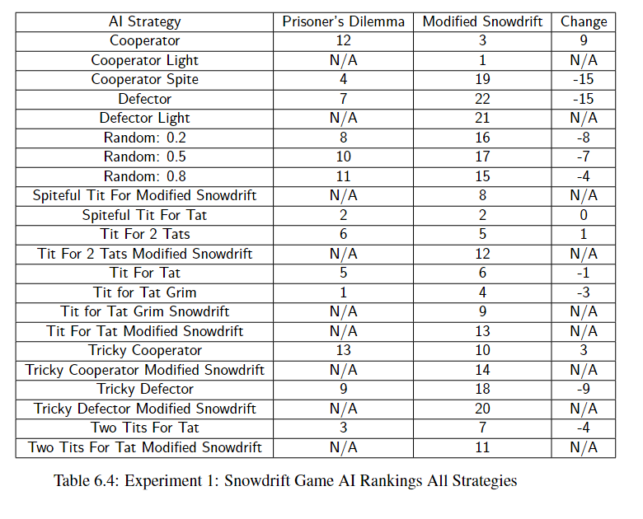

Slide 49
2nd game
2 player, plus sum game, simultaneous
Each player gets a choice of investing money into a group, or keeping money for themselves ({10, 0}, {7, 3}, {3,7}, {0,10})
Players placed money into a central pot which was given a 10% bonus at the end of the game and split between players

Slide 50
Examples
Player 1 pay in | Player 2 pay in | Total Player 1 win | Total Player 2 win
10 | 10 | 11 | 11
10 | 7 | 9.35 | 12.35
10 | 3 | 7.15 | 14.15
7 | 0 | 6.85 | 13.85
0 | 3 | 11.65 | 8.65

Slide 51
Experiment 2
114 human players and each was asked to play against a different AI strategy until they did not want to play anymore
Strategies were then ranked by modal (most common) number of plays and and by mean amount of earned money

Slide 52
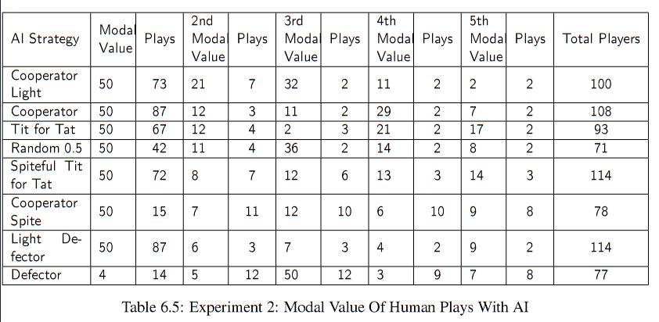
Number of Plays vs a human player

Slide 53
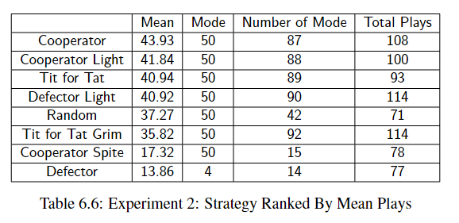
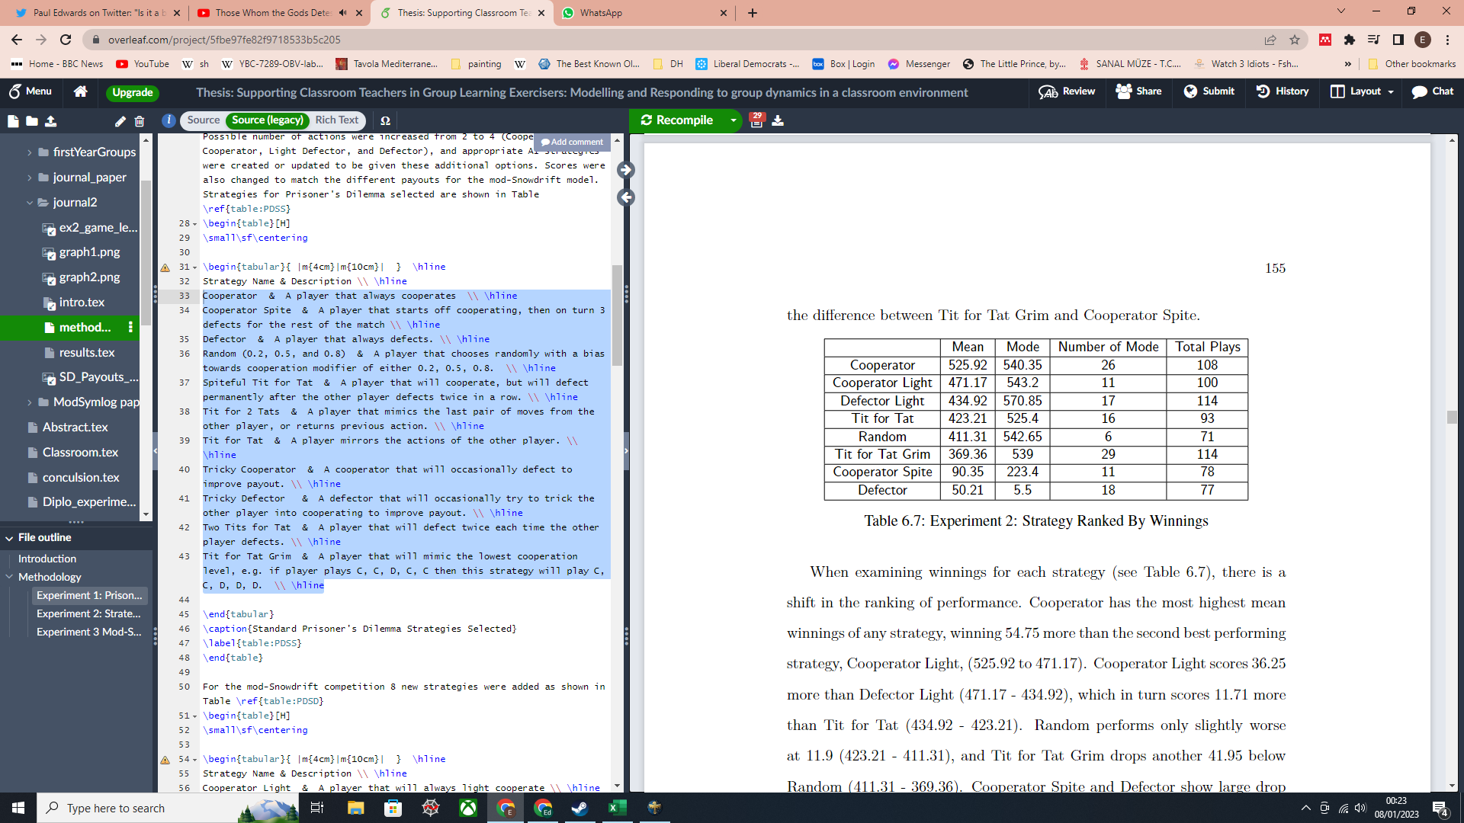
Comparing number of plays and winnings

Slide 54
Summery
All games are combination of: Cooperation/non-cooperation, sequential/simultaneous, and plus/zero sum
Games are further developed by level of information, payout and costs of actions, symmetry of these payouts/costs, and how many times the game is played
All situations can be modeled as different sorts of games, and this allows us to build mathematical models out of them

Slide 55
Lab work today
Today you need to play the games we have learnt today with other groups, and try to earn more points for your team
Unsuspecting tyrant double decker beef fort - 95 points
Explosive Dolphins - 75 points
Top G - 32.5

Slide 56
Game 1 Chicken
If after 3 turns you are both going straight, both teams lose
Player 1 Player 2 | Swerve | Straight
Swerve | 0, 0 | 10, 0
Straight | 0, 10 | -30, -30

Slide 57
Game 2 - Prisoner’s Dilemma
Note that payouts are negative
Player 1 Player 2 | Stay Silent | Betray
Stay Silent | -5, -5 | 0, -20
Betray | -20, 0 | -10, -10

Slide 58
Auction game
10
20
10
Round 1 bidding -
Round 2 bidding
Round 3 bidding
40
10
10
15
15
30

Slide 59
Lab work
Identify the games that best fit 5 scenarios - I will give you 3, you have to decide on 2 others
Buying a car
Splitting time between university work and social activities
Applying for jobs

